Slide 1
Advanced Github Topics
InstructorS –
Zach martin & Chris Daniels

Slide 2
Initial resources and Introductions
https://github.zach-martin.com/advanced.html
A quick introduction –
Zach Martin
14 years IT experience
4 years professional software development experience
Father to a seven-month-old baby girl
Chris Daniels
Heads up the 1819 Initiative at UC
7 years professional software development experience
Father to a five-month-old baby boy

Slide 3
Presentation Objectives
Advanced Git Tactics
Rebase – What it is and when to use it
Forking vs. Cloning
Tags – $20 in my pocket?
Advanced GitHub Features
Actions and Workflows to build a CI/CD Pipeline
Secrets and how to use them
Pull Request Management
Issue Tracking and Projects

Slide 4
Rebasing vs. Merging
Merging
Explicitly define what stays and what goes
A new commit with these specifications is created
Rebasing
“Replay” one branch at the end of another
Cleaner tree with no additional commit

Slide 5
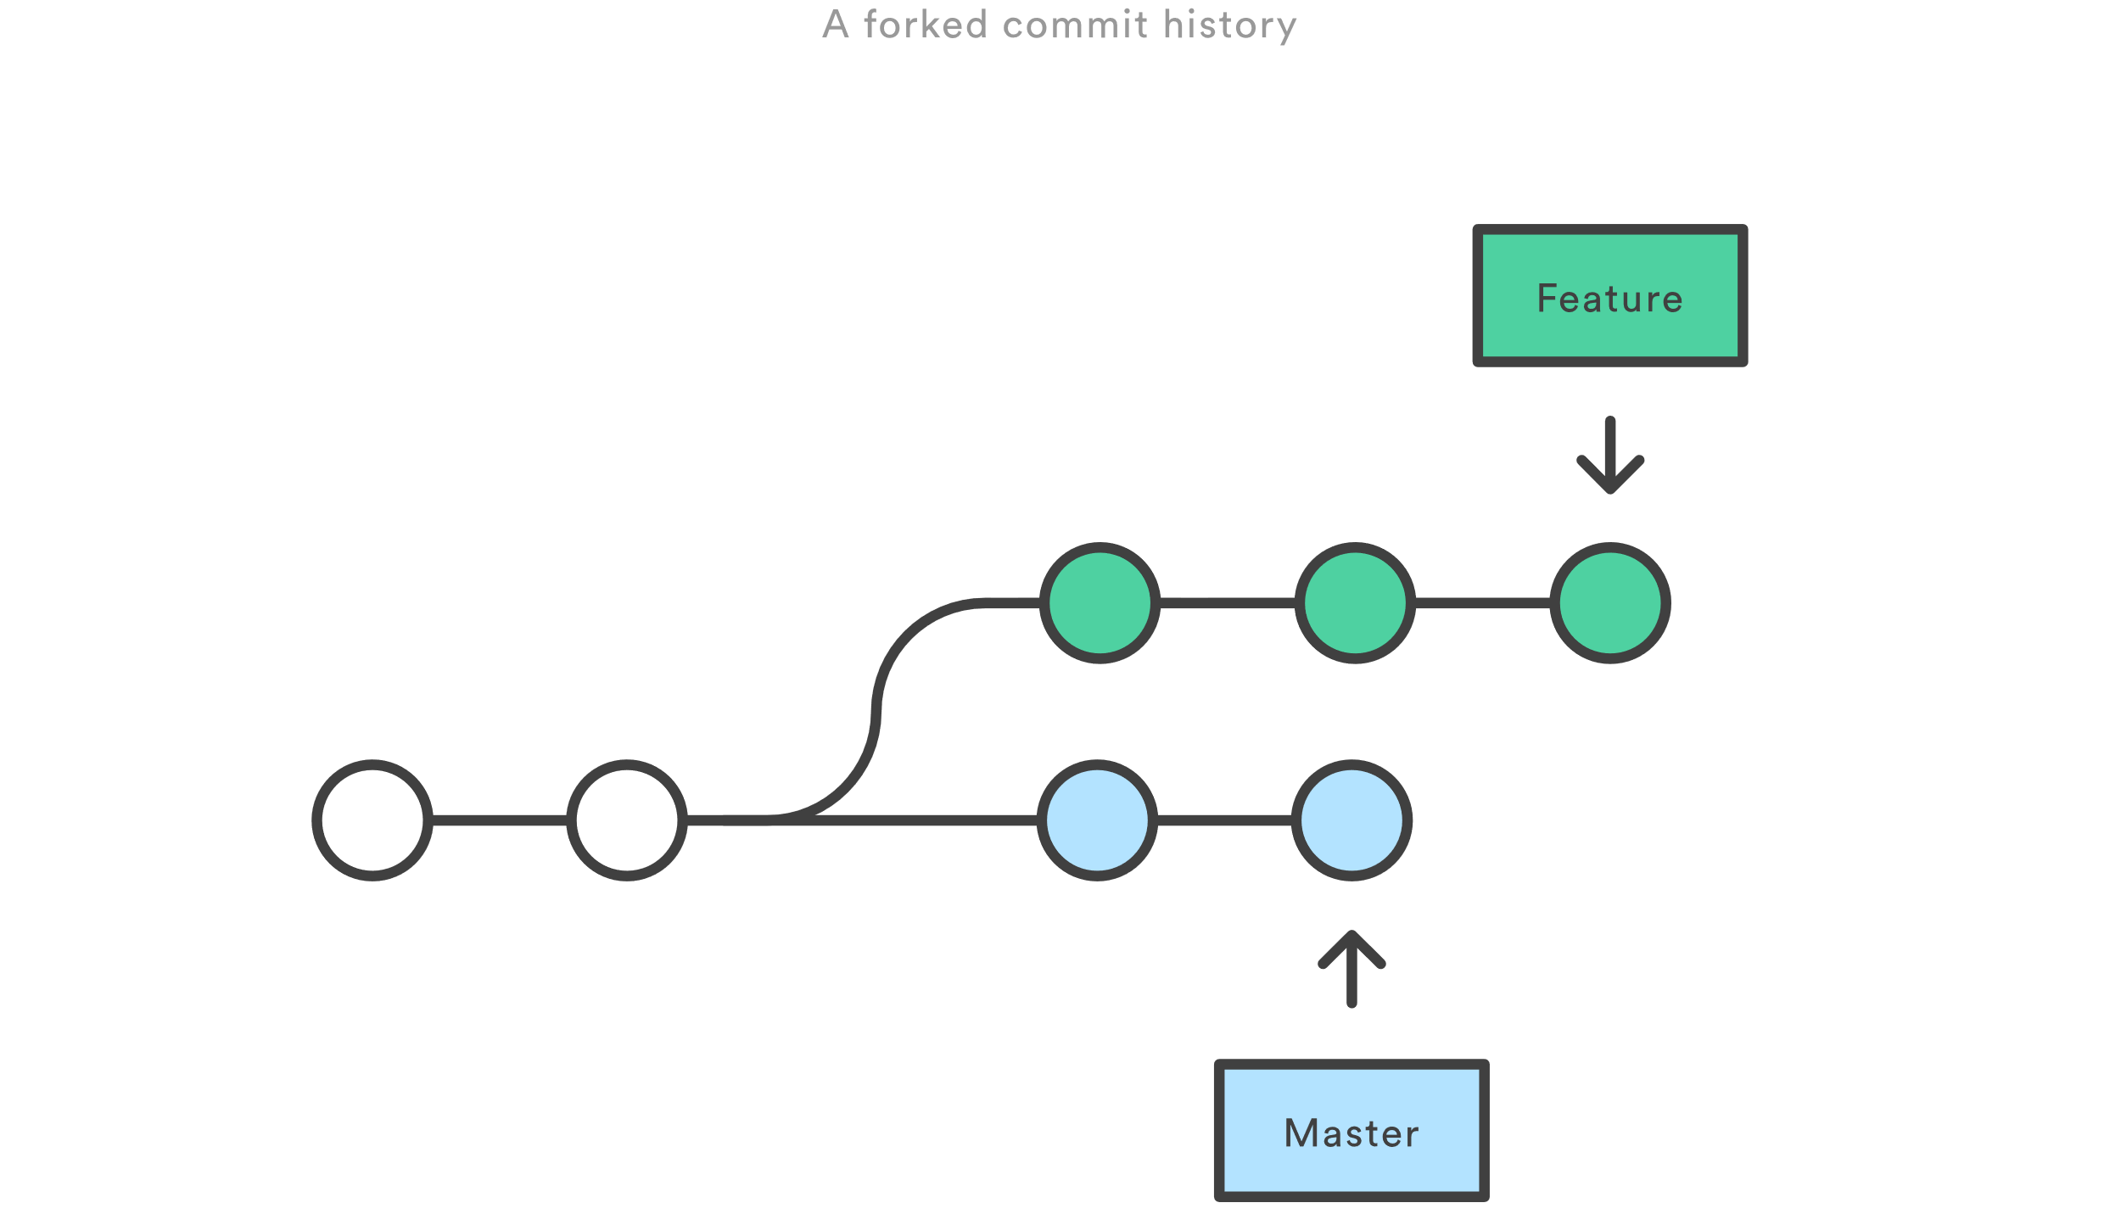
Rebase workflow

Slide 6
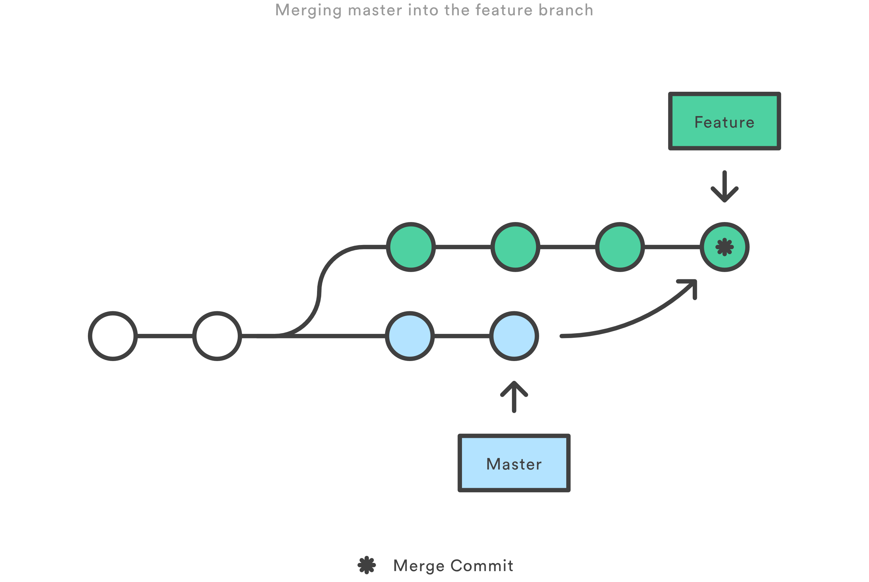
Rebase workflow (Cont.)

Slide 7
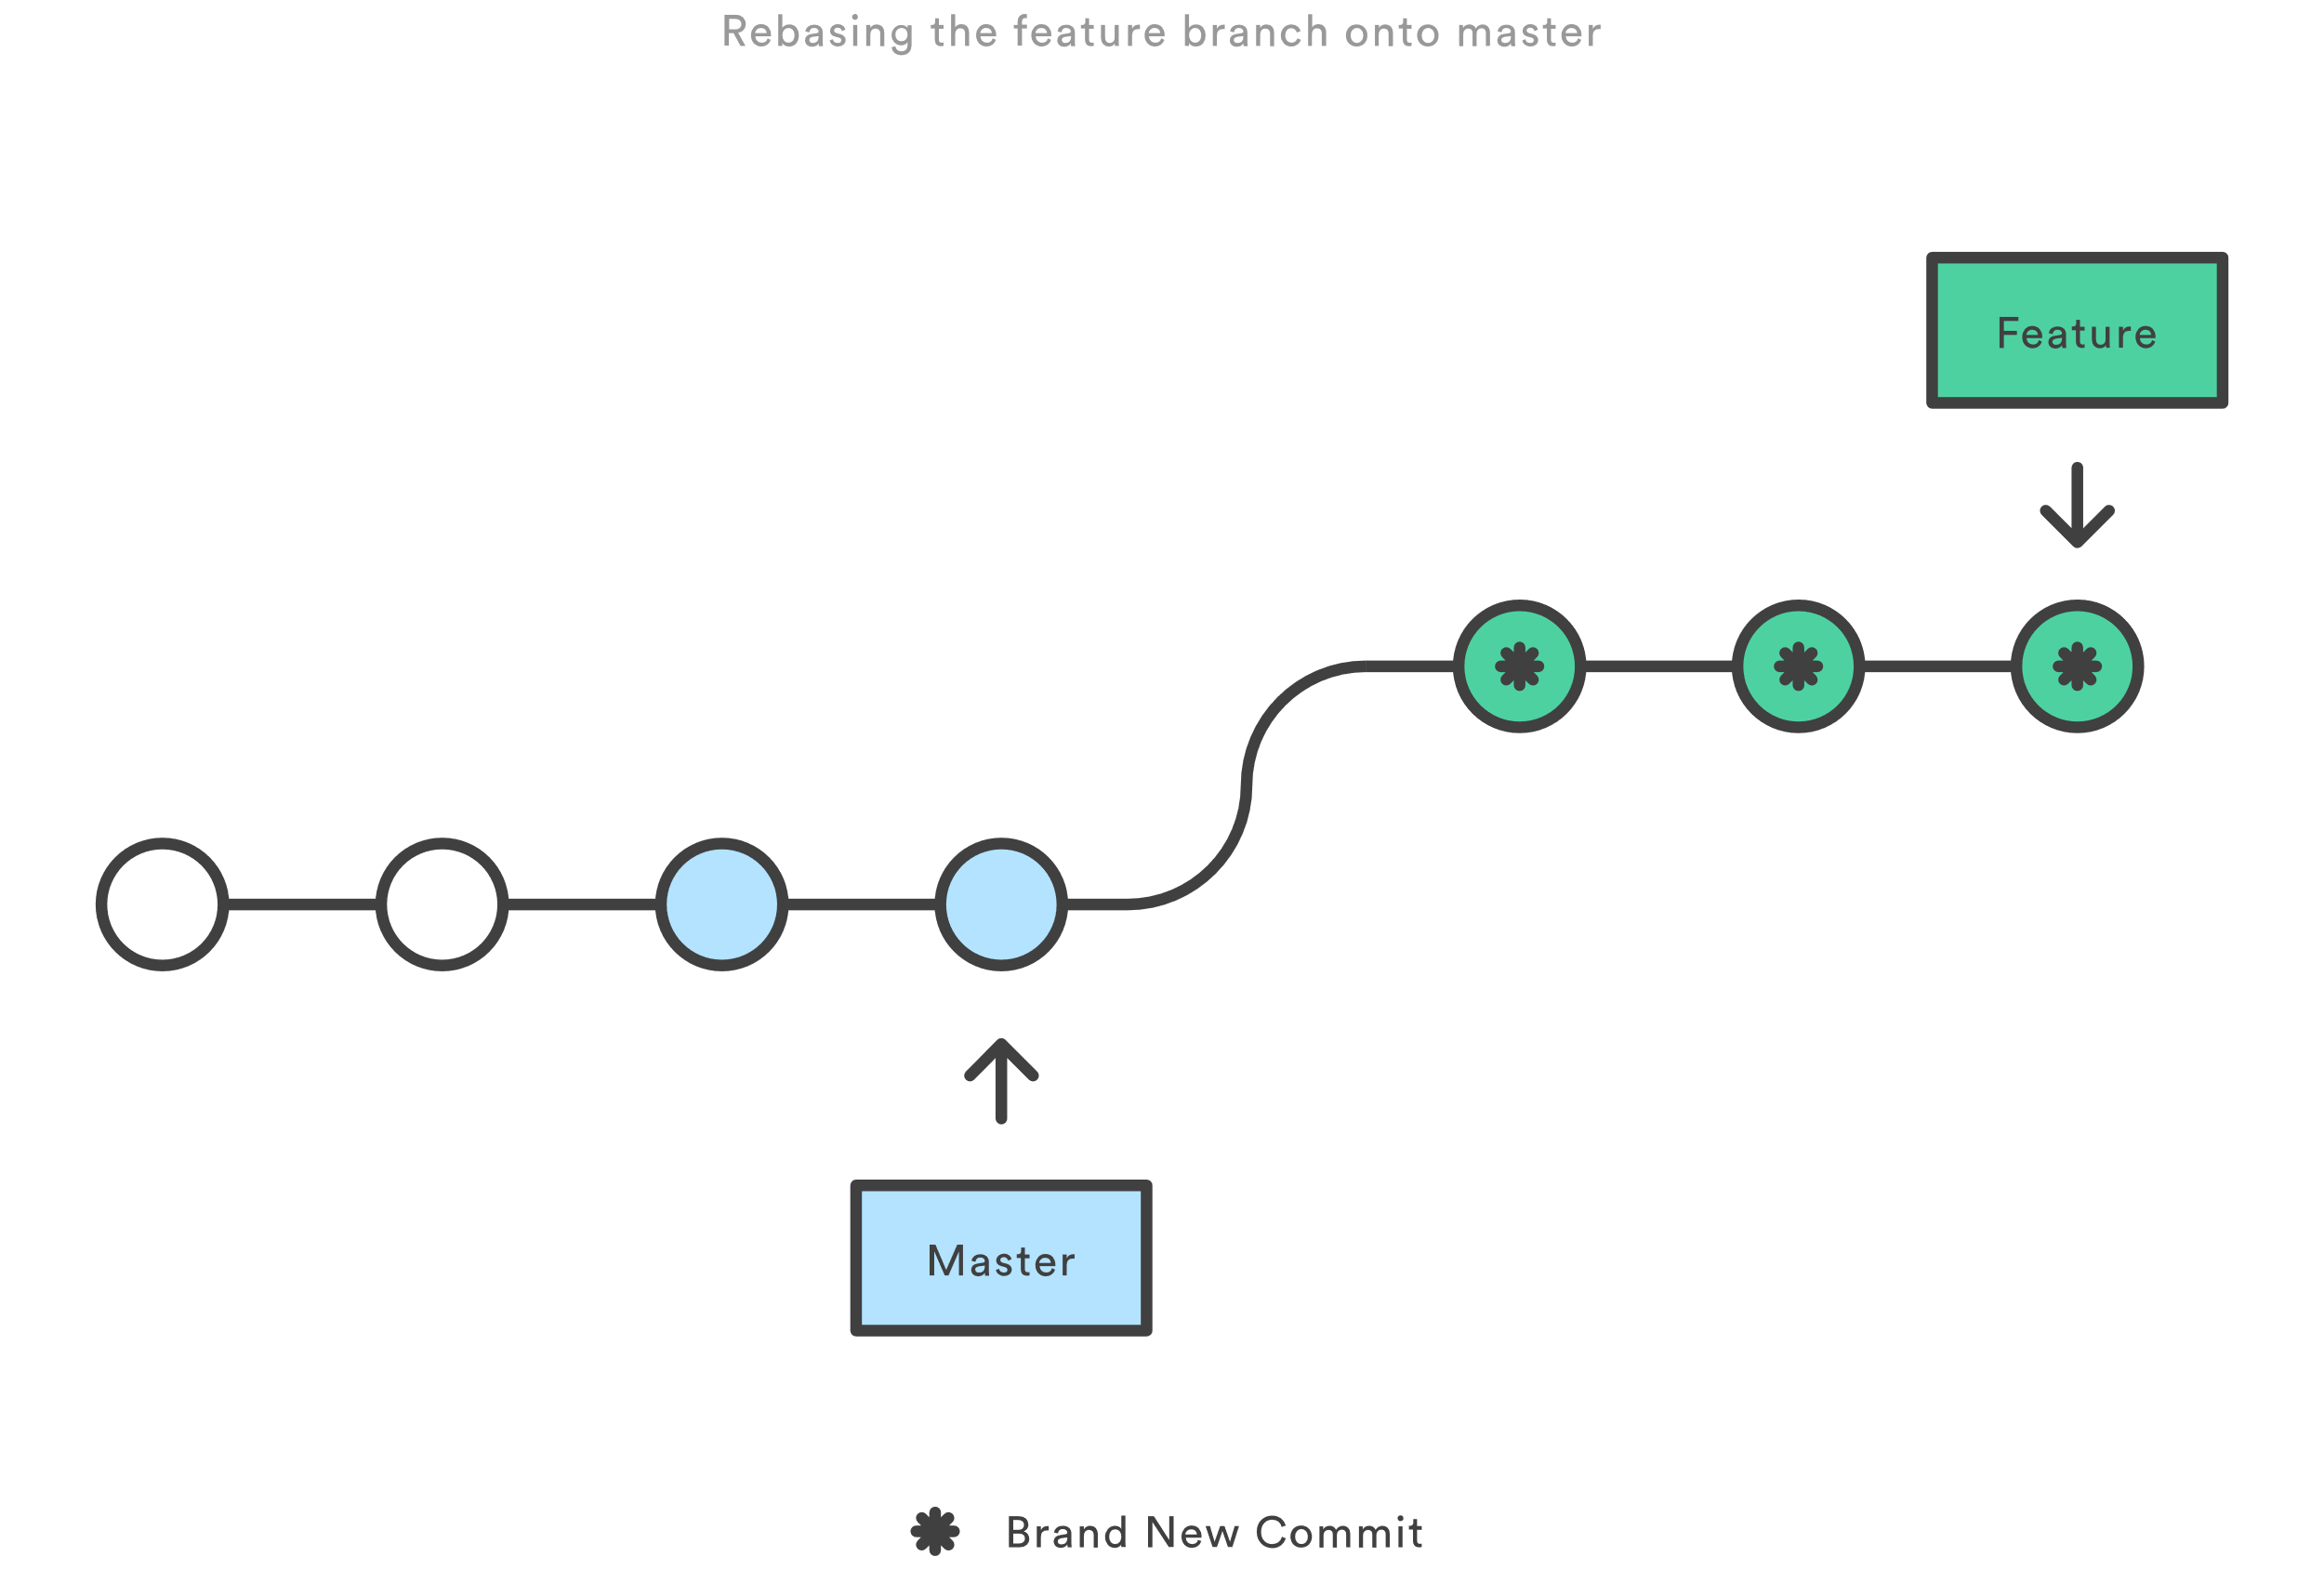
Rebase workflow (Cont.)

Slide 8
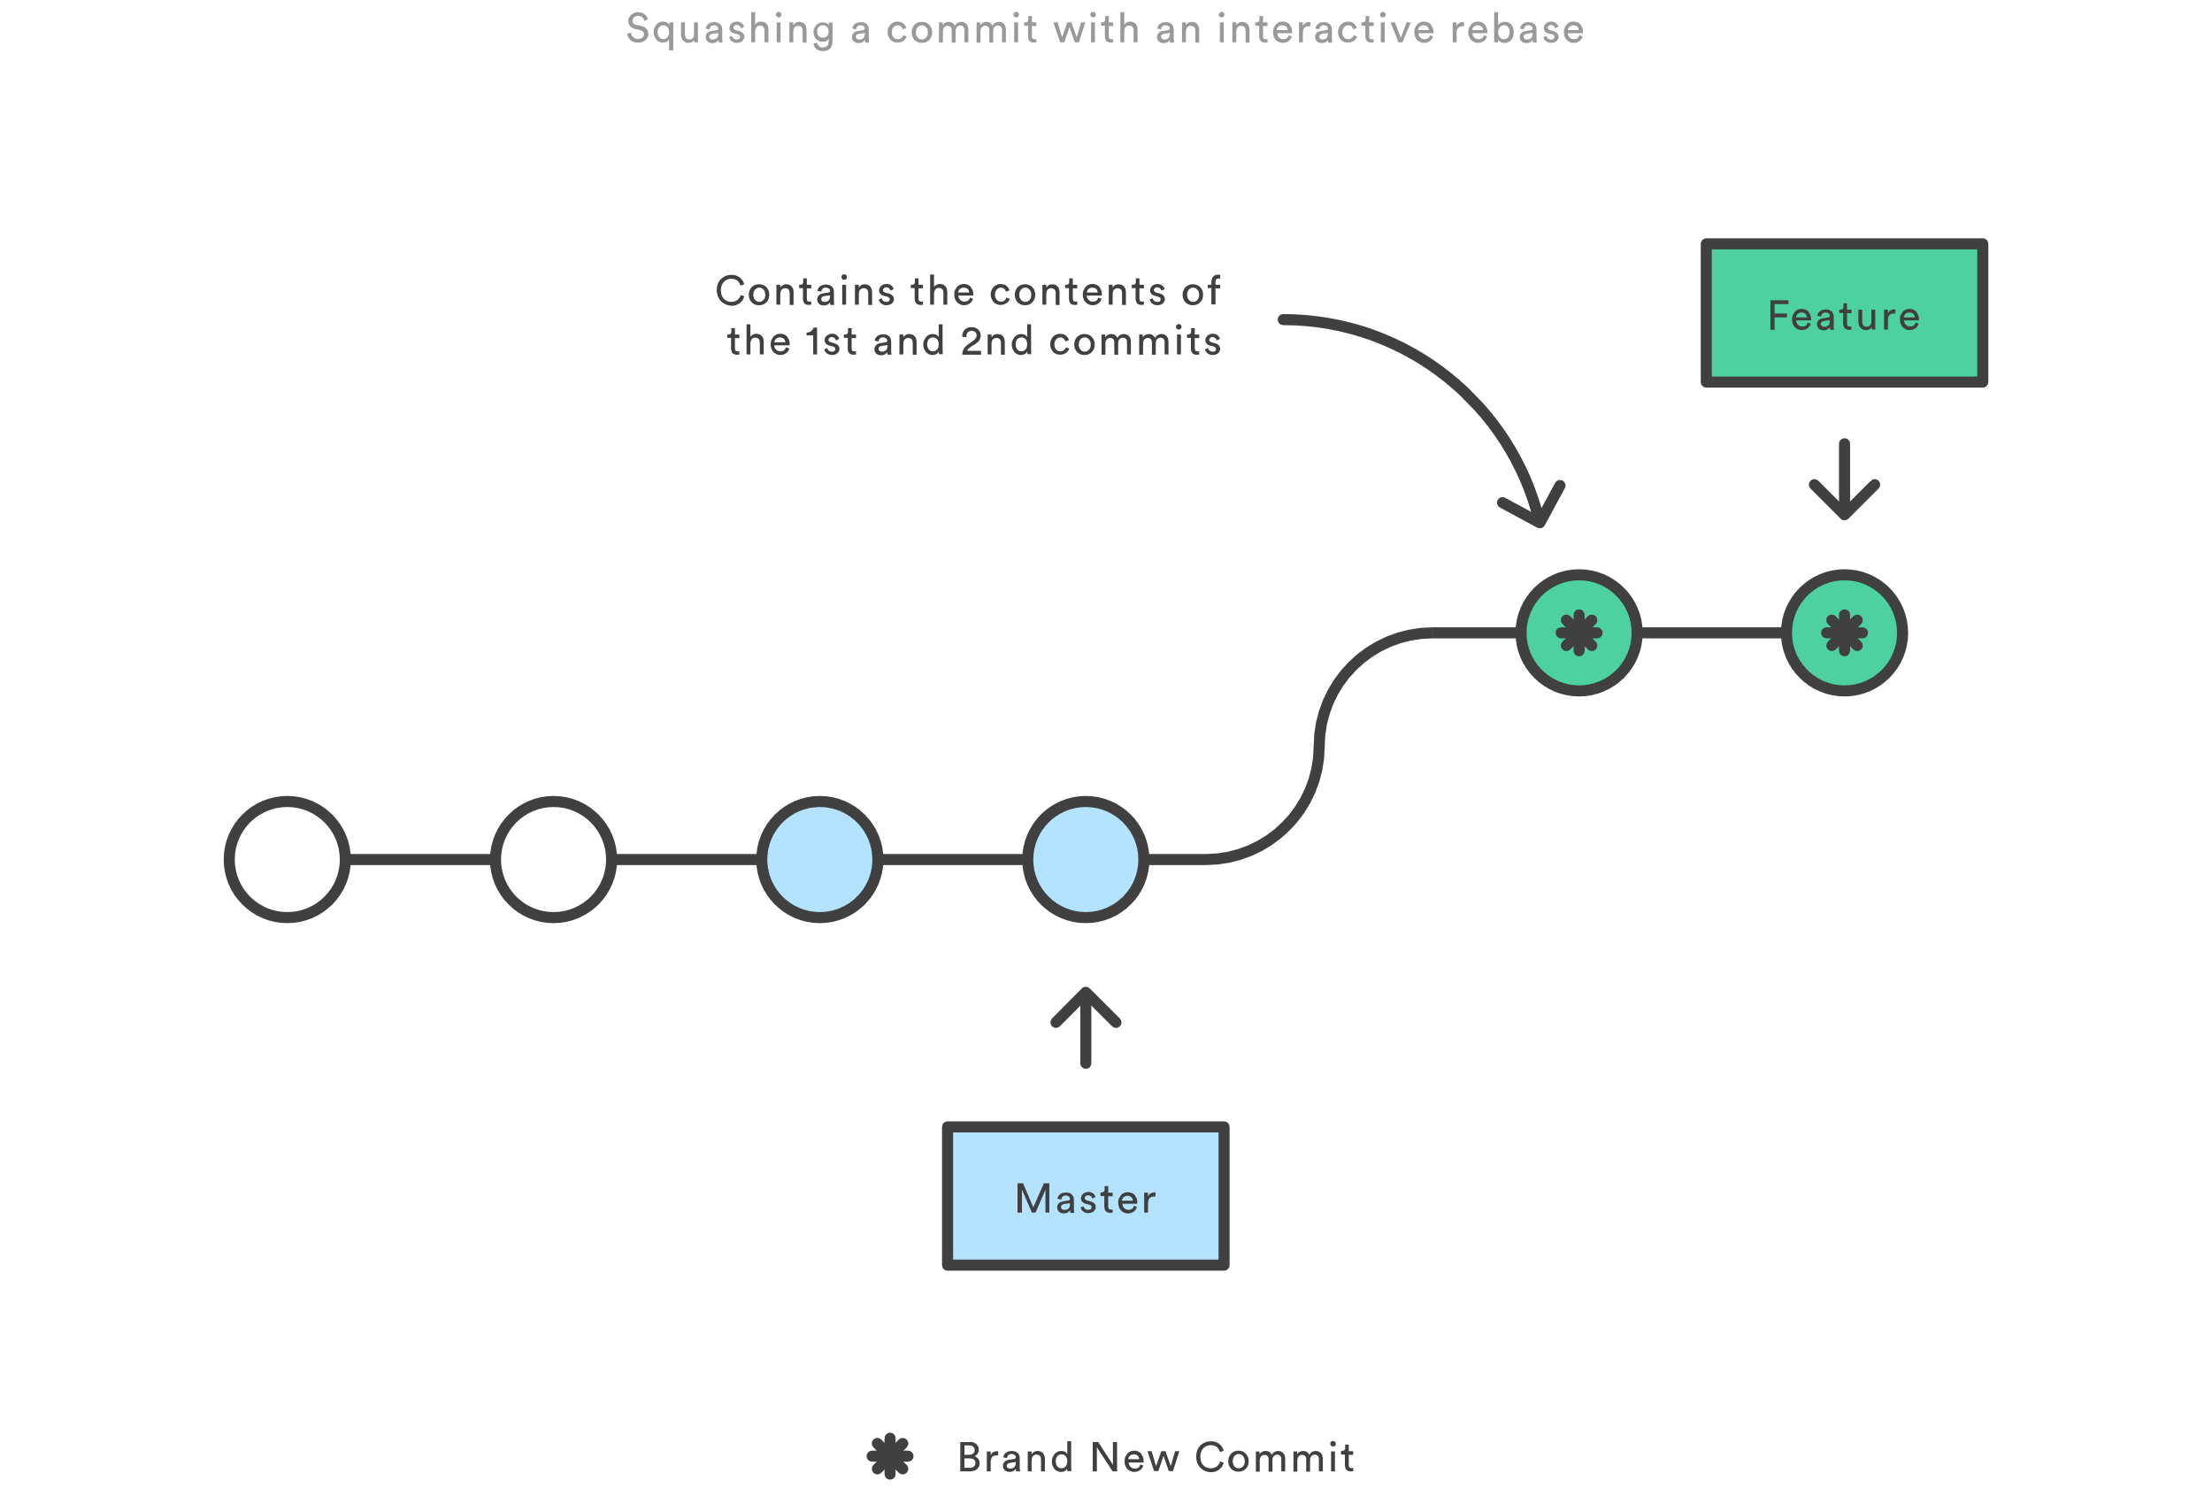
Rebase workflow (Cont.)

Slide 9
Rebase golden Rule
When rebasing, keep the golden rule in mind:
NEVER rebase a public branch over your branch
Rebasing gives you an opportunity to realign your history with team changes
Don’t make others have to realign around your own changes

Slide 10
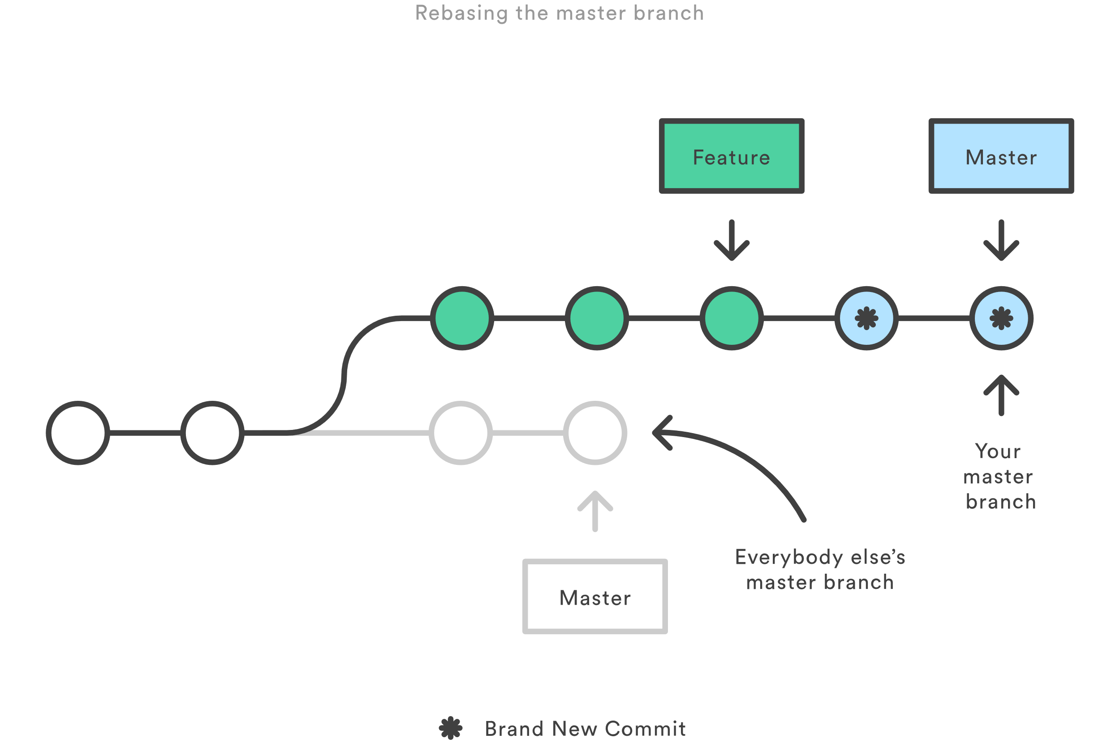
Rebase golden Rule - Illustrated

Slide 11
Rebase golden Rule - Illustrated

Slide 12
Leadup to lab 1
Rebase not only helps keep a clean tree, it can reduce clutter
Maintaining clean commit histories can be challenging
Consolidating commit messages and removing unnecessary commits
Alter history itself! (You can do some weird stuff with rebase!)
Important rebase terms:
Pick
Squash
Edit
Reword
Drop

Slide 13
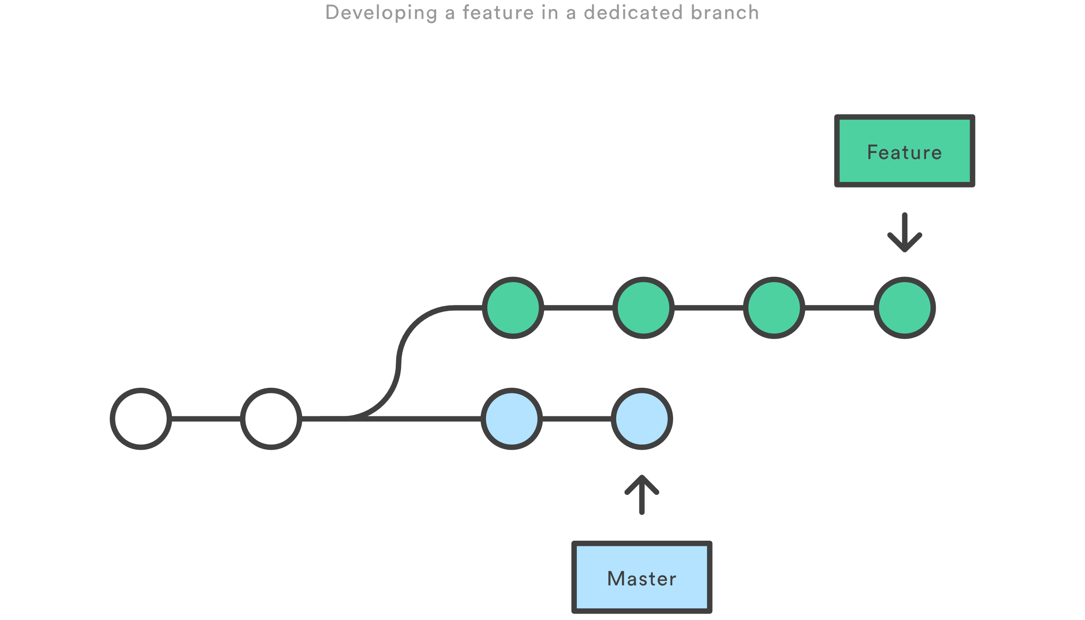
Lab 1 – Interactively rebasing

Slide 14
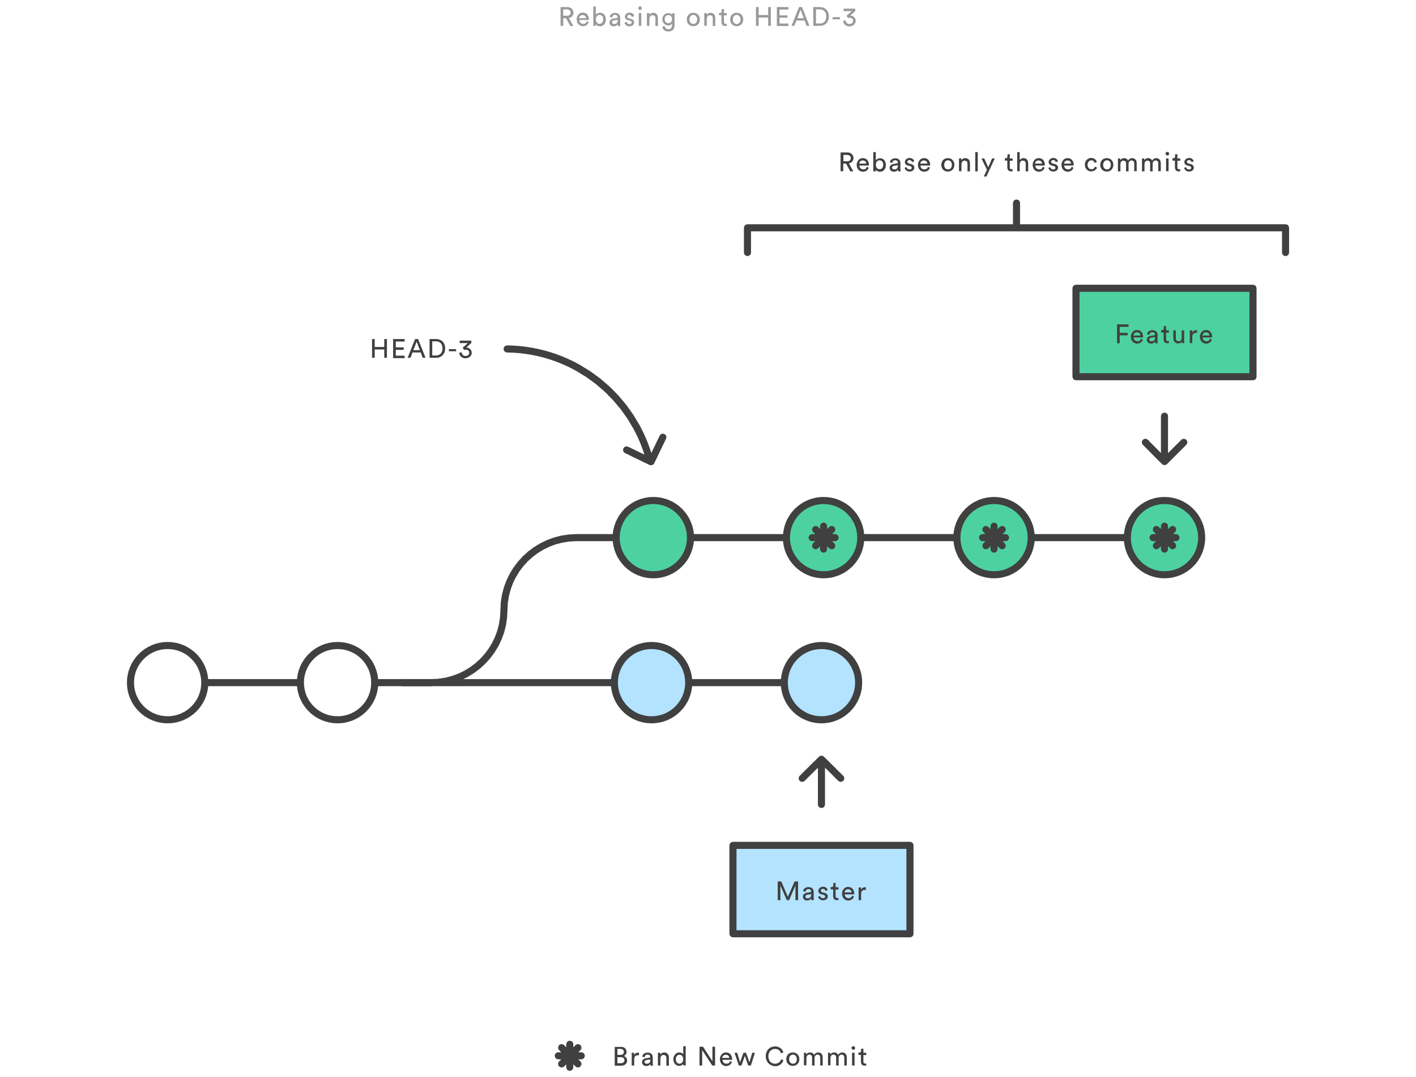
Lab 1 – Interactively rebasing

Slide 15
Lab 1 – Interactively rebasing
Create a new branch, called lab_1, and change to that branch
git branch lab_1
git checkout lab_1
Make a minor change, for our example we’re creating a temp file and updating it, and then commit that change with the commit message “commit 1”
echo “change 1” >> tmp.txt
git add tmp.txt
git commit –m “commit 1”

Slide 16
Lab 1 – Interactively rebasing (Cont.)
Do the same steps we did before, twice more, but incrementing the commit message by one each time (“commit 2”, “commit 3”)
echo “tmp” >> tmp.txt
git add tmp.txt
git commit –m “commit #”
Once finished, confirm that all commits and changes are in place and no files are pending commit (this prevents a rebase from occurring)
cat tmp.txt
git status
git log

Slide 17
Lab 1 – Interactively rebasing (Cont.)
We’re now ready to interactively rebase and clean up our commit history
git rebase –i HEAD~3
Squash commits 2 and 3 in the editor
Clean up the final commit message to now say “commit 1 with changes 1, 2, and 3”
git log
We now have a cleaner git history

Slide 18

Forking workflow
The Forking Workflow is most often seen in public open source projects.
The main advantage is that contributions can be integrated without the need for everybody to push to a single central repository

Slide 19
Branching differences
Everybody should still be using branches to isolate individual features, the only difference is how those branches get shared.
In the Forking Workflow, they are pulled into another developer’s local repository, while in the Feature Branch and Gitflow Workflows they are pushed to the official repository.

Slide 20
Getting started
All new developers to a Forking Workflow project need to fork the official repository
Forking is just a standard git clone operation
This will clone the original repository to our own server-side repository
Git hosting services automate this step without the need of SSH’ing into a server to clone

Slide 21
Clone your fork
Clone your own public forked repo
This can be done with the familiar git clone command
Git clone https://github.com/user/repo.git

Slide 22
Adding a remote
The Forking Workflow requires two remotes
one for the official repository
one for the developer’s personal server-side repository
A common naming convention is to
use origin as the remote for your forked repository
This will be created automatically when you run git clone
upstream for the official repository
git remote add upstream https://github.com/user/repo.git

Slide 23
Making changes
In your local copy of the forked repository, you can edit code, commit changes, and create branches just like in other Git workflows
If the official repo has moved forward, you can get the latest change with “git pull upstream master”

Slide 24
Making a Pull Request
Now you’re ready to make your new feature available!
First, you have to make your contribution accessible to other developers by pushing it to their public repository
git push origin feature-branch
Second, you need to notify the project maintainer that they want to merge their feature into the official codebase
Github provides a “new pull request” button that leads to a form asking you to specify which branch you want to merge into the official repository.
Typically, you’ll want to integrate your feature branch into the upstream remote’s master branch.

Slide 25
Presentation End – open lab and questions
Can’t think of a question or need to leave before I can answer?
No worries! Send me an email – zach@zach-martin.com

